Slide 1


Unsupervised Multimodal Matching
in social media posts
Coco Diru GQ Jiang Kyle Wenqi
Date: 11/12/2021
Notes:
Hi everyone This is Team 5. We have Coco Diru Jiang Kyle and I’m GQ. Our teammate Wenqi has hurt his hand, so unfortunately, he can’t be with us today.
So today we gonna introduce our project with MVP. Our project is called Unsupervised Multimodal Matching in social media posts. It’s obvious that we use unsupervised methods to match similar posts based on multimodal information. So firstly, what are we doing?

Slide 2

WHAT?
Motivation
Hashtags, categories: not specific
Search: keywords only, not comprehensive
Notes:
[GQ]
○ It’s more like a project for fun. The problem is that when we’re using social media. I’m interested in certain post and I wanna see more, what should I do?
○ I go for the hashtags, or its category. But the more common situation is that I’m interested in some specific topic. Like I posted something, and I wanna know who’s having the same thought with me. It’s not popular enough to have a hashtag, andits category is way too general.
○ So I will turn to searching. However, search in social media is mainly just keywords only. And it’s not comprehensive, because not everyone express their thoughts in the text. There’re much more information in the images. [Example]

Slide 3
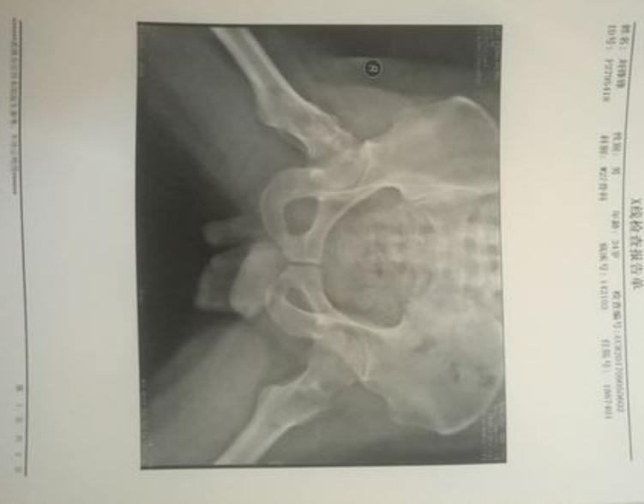
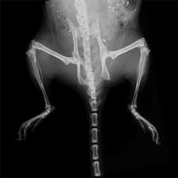
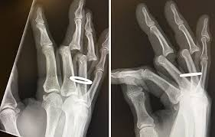
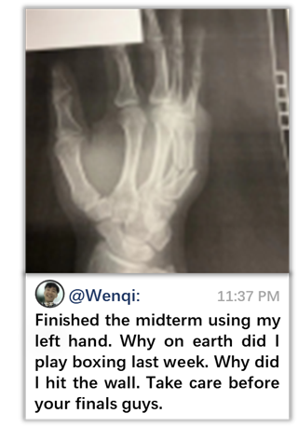
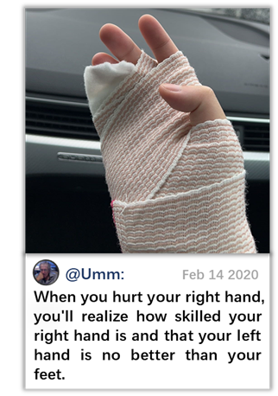
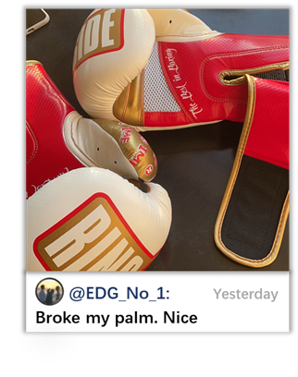
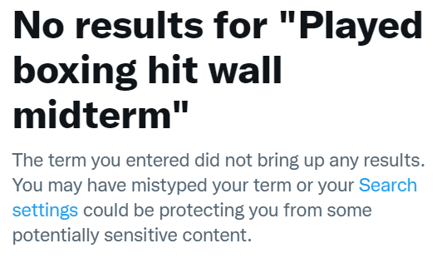
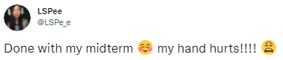
WHAT?
Motivation
Notes:
[GQ]
Wenqi example: his injury and how he survive the midterm by his left hand.
he wanna know who’s same. Ideal results like these posts
No hashtag ‘I hurt my right hand before midterm by boxing’
And if I search by image… If I search by text…
We can see boxing keyword is in image, injury keyword is in text
So what we wanna do is to combine these information to get a better search result.

Slide 4
WHAT?
Motivation
Hashtags, categories: not specific
Search: keywords only, not comprehensive
Goal
Unsupervised: Find similar posts (No label in real life)
Multimodal: Combine the information from both Text & Image
Matching: Implement as a search by post function
Notes:
[GQ]
Therefore, our project goals is just our title.
○ Unsupervised: Maybe we’ll based on supervised label like categories first, but the core method to match the posts is unsupervised. Because there’s no specific label in real life. Also we don’t know what the topic gonna be like, so we can’t manually label them.
○ And to get the comprehensive information based on the complex scenarios in social media, we want to combine both information from Text and Image
○ At last we want to implement that as a embedded function, search by post.
Now we can go to the Marketing side.

Slide 5
WHY?
Target Market
We are looking to offer this product as a B2B software that can be integrated into existing tools. Use cases span from consumer implementations to internal business applications. On the consumer side, social media companies, and additionally forums and sites offering search engines could utilize this tool to allow their users a better search experience. On the internal business side, the use cases for this tool could span from database search to inventory management.
Accessing the first customer
As this is a B2B product, a sales team will have to have to make a case that the target business’s users would largely benefit from this technology. Therefore, showing a comparison of existing search tools alongside our product could show how much this increases user experience and retention on a given site. For user testing, we are planning an AB test, the results of which can be included in our B2B sales strategy.
Notes:
[Coco, Kyle] Why are we doing this? Like BA side, marketing, user interview, stuff like that. Feel free to change the subtitle~

Slide 6
WHY?
User Testing
Question to users
1. What is your need related to ____? | From the perspective of social media users, they’d like to search for similar content online based on their own posts and interests The persona of social media influencers still have yet to be tested
2. Can you talk aloud your expectation and experience while moving through the app? | Overall positive experiences with the UI Expected the platform to be more well-integrated with existing social media platforms instead of on a separate site
3. As a user, why did final output help or not help your decision- making with your problem? | Finds closely relevant images Finds people with similar hobbies Easily index inventory without having barcodes or specific product info
4. Was the effort in the app worth the return and why? | The effort was worth it because with existing posts on your platform, to it was simply with the click of a button
Easy or Difficult? | Easy
Notes:
[Coco, Kyle] Why are we doing this? Like BA side, marketing, user interview, stuff like that. Feel free to change the subtitle~

Slide 7
User testing each other at class: Template to complete
Individuals on the same team can’t test the same user.
Observe if/when user has ease or difficulty to 1) use your app and 2) make an end-of-task decision (e.g., watch movie)? Note: What users do can be more accurate than what they say. Sometimes what users say (“app helped me”) doesn’t match what they do (“exit app without watching a movie”).
Question to users | User 1 [Logan S] tested by [GQ] | User 2 [Name] tested by [Your Name] | Tester 1 [Kevin L] on User [Coco Sun] | Tester 2 [Name] on User [Your Name]
1. What is your need related to ____? | Finding similar pictures on social media. |  | As a leisurely investor, I want to find a tool that can help with my decision-making when it comes to whether or not I should invest in a stock
2. Can you talk aloud your expectation and experience while moving through the app? | Expected to see other posts about something similar to picture (in this case, broken hands) |  | I expected to see some visualizations of today’s stock trends based on the sentiment analysis
3. As a user, why did final output help or not help your decision- making with your problem? | Yes. It addressed initial problem |  | Yes it did, it also fit with what I had expected based on news I read this morning
4. Was the effort in the app worth the return and why? | Yes. Worth the click. Easy. |  | Yes, it was very easy to use (only had to type in a clicker and hit a button).
Easy or Difficult? | Easy |  | Easy
‹#›

Slide 8
User testing each other at class: Template to complete
Individuals on the same team can’t test the same user.
Observe if/when user has ease or difficulty to 1) use your app and 2) make an end-of-task decision (e.g., watch movie)? Note: What users do can be more accurate than what they say. Sometimes what users say (“app helped me”) doesn’t match what they do (“exit app without watching a movie”).
Question to users | User 1 [Kelvin] tested by [Kyle] | User 2 [Lennon] tested by [Kyle] | Tester 1 [Kelvin] on User [Kyle] | Tester 2 [Name] on User [Kyle]
1. What is your need related to ____? | Finding similar posts for copyright purposes | Facial Recognition Purposes | FInding what classes I should take for PM roles. | Finding Traffic Data Quickly
2. Can you talk aloud your expectation and experience while moving through the app? | FInding the most relevant post or exact copies | To be able to put in a face and find person they are looking for. | Expecting both soft and technical skills for PM roles. Potentially skill sets for specific companies | Was expecting clear graphs and visualizations
3. As a user, why did final output help or not help your decision- making with your problem? | Yes, able to find similar posts | No, we don’t have a facial recognition database. | Yes, all information aggregated in one place rather than than searching specific job posts. | The final output was very clean, but the backend wasn’t linked yet so it didn’t show much concrete data
4. Was the effort in the app worth the return and why? | Yes. Upload file and go. | Yes. Even though didn’t work for facial recognition, you can scan an item. | Yes, saves a lot of time | Yes, faster than searching data on Google
Easy or Difficult? | Easy | Easy | Easy | Easy
‹#›

Slide 9
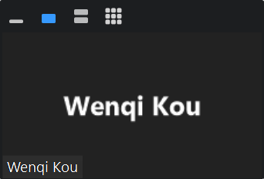

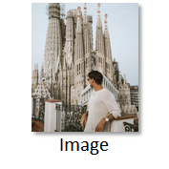


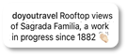

HOW?
Feature Extraction
“Landscape/Tourist”
Image Categorization API
[Json]
“Travel”
[Json]
Text Categorization API
Notes:
[Wenqi] And now we can go to how we gonna do this.

Slide 10
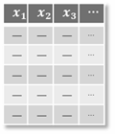
HOW?
Early Fusion: Feature Combination
“Travel”
B E R T
concat
“Landscape
/Tourist”
Late Fusion: Clusters Combination(Voting)
Notes:
[Wenqi] And how do we do the combination?
String format features. Concatenate them, using bert, numeric data for model.
But we’ve used such feature extracting models several times, we’ll lose much information.
So a better try will be using late fusion. Time permitting, ensemble three clustering.
A much more complex way is to try intermediate fusion. Using NN, combine them in hidden layers. It’s something to work with for future work.

Slide 11
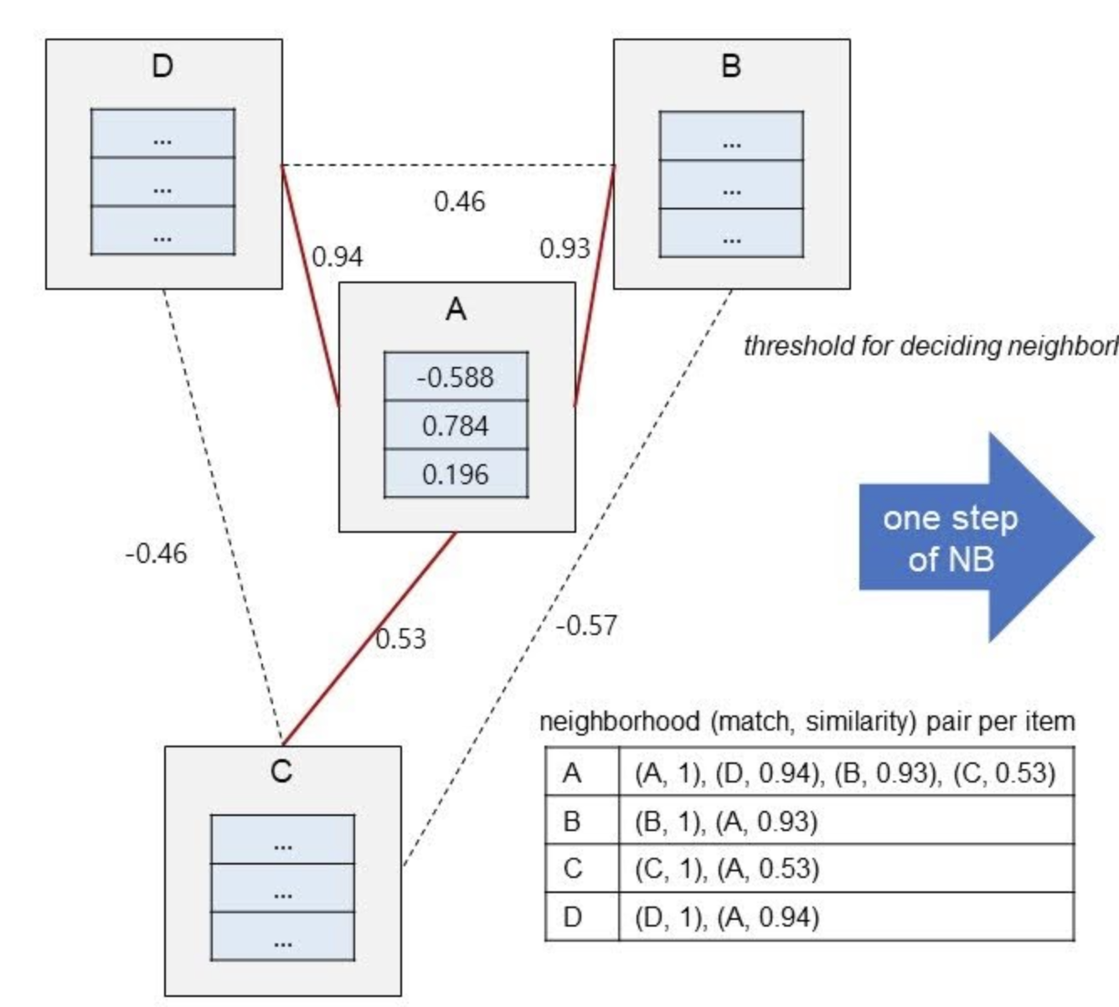

HOW?
Unsupervised Model
K-means
Number of clusters are predefined and limited
Time consuming
K-Nearest Neighbor Search
Use Euclidean distance as similarity metric
Choose the top 5 nearest neighborhoods as
recommended similar posts
Acceleration
RAPIDS cuML
Faiss
Notes:
[Diru] How to use unsupervised model to match a given post.

Slide 12
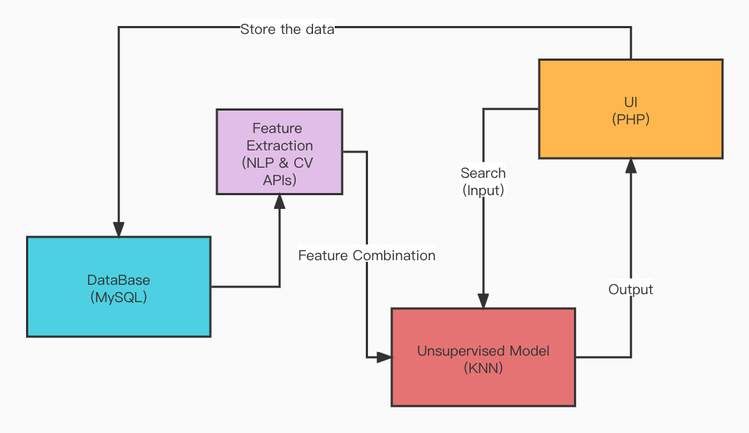
HOW?
Deployment Structure
Notes:
[Jiang] So about our architecture, we uses MySQL as the database, and all posts and account information are stored in the database. These data are used as a dataset to NLP and CV APIs for feature extraction, and then they are combined and use the KNN algorithm to build a model. The user can click the search button on the ui to search and you will see similar posts. Finally, the user’s new posts and feedback will be stored in the database, and we will have a larger data set, which also means a better model.

Slide 13
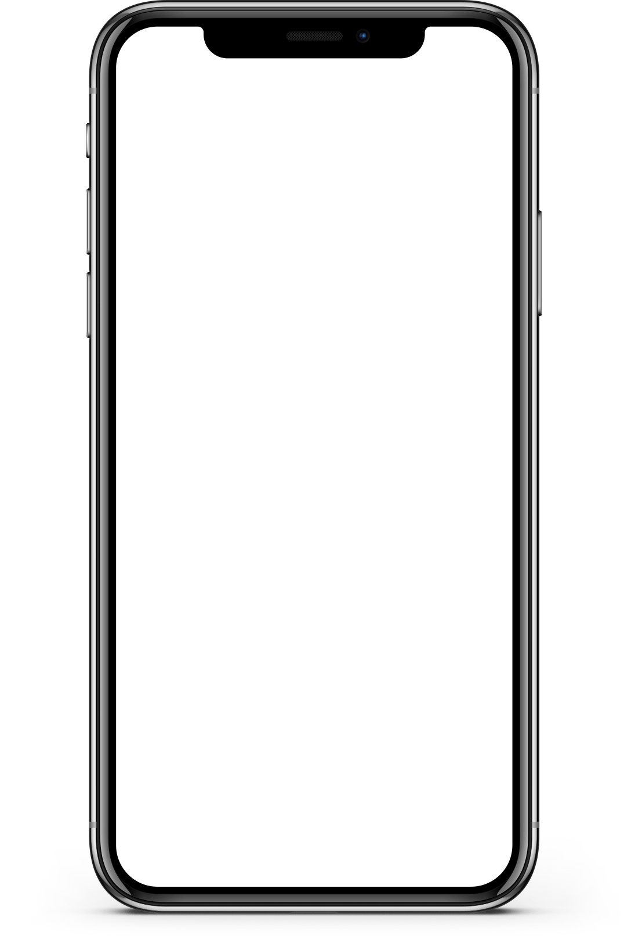
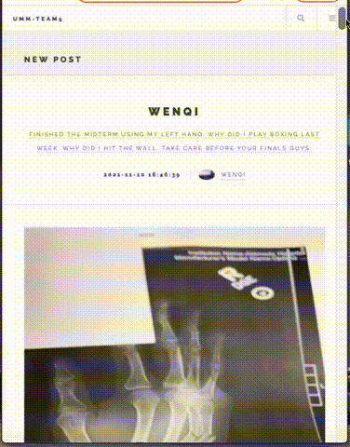
UMM?
Notes:
[GQ, Jiang] Although we’re still working on the optimization of our algorithm. Jiang has made a testing UI for our project. As we can see, it’s a home page of social media. We can see all the posts here sorted by time.

Slide 14
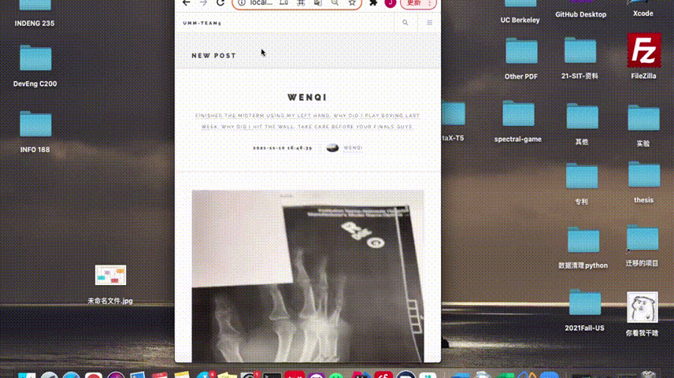
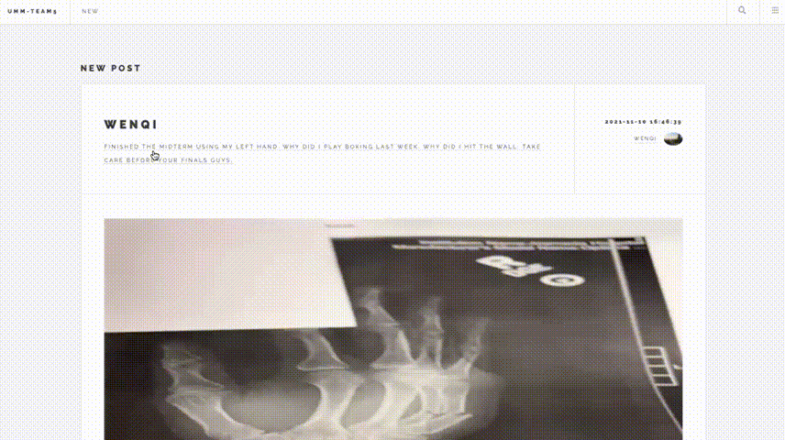
UMM?
Notes:
[GQ, Jiang]
Also, we can log in to post, and we can click into one posts to see details. here’s the text, here’s the images. With it’s username and date of the posts.

Slide 15

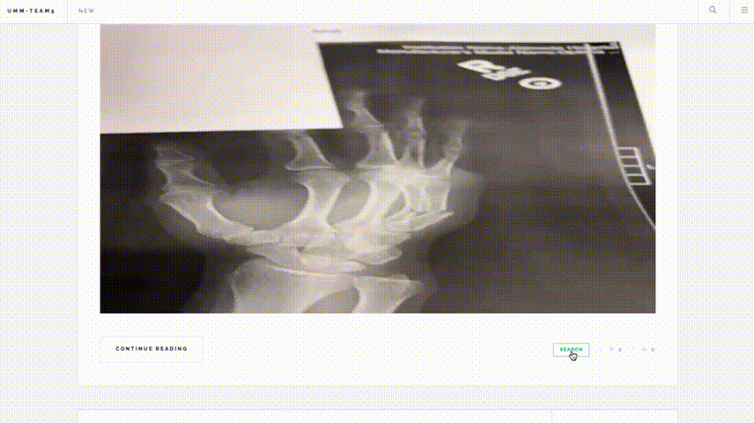
UMM?
F i n d ou t w h o’s w i t h y o u !
Notes:
[GQ, Jiang]
It’s just like all social media except, there’s a search button under the post. If you click it, you’re get the search result based on both image and text. Just like a search engine, but in social media for posts.
So our project can be a project for fun. Find out who’s with you. But if the feature extraction and clustering has better performance, it can gather the information among huge amount of social media posts. It’s common that someone has a question, someone has an answer, but searching or hashtags won’t bring them together. Hopefully one day machine can do it.

Slide 16
Next Steps?
Product Line for Different Verticals
Whitelabel the original algorithm and package it for each use case
Social Media/Discussion Forums: Search Improvements
Retailers: Inventory management
Supervised Shift
Eventually, improve algorithm based on user search feedback

Slide 17
· Team 5 ·
Coco Sun
Diru Jia
GQ Gaoqu
Jiang Qu
Kyle Atkinson
Wenqi Kou
Unsupervised
Multimodal
Matching
Notes:
That’s all about our project for now. Thanks for listening.

